Slide 1
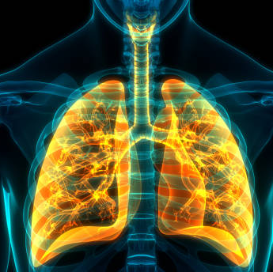
Simplified models for gas exchange for lungs of human body Respiratory system
Presented to:
Doctor/Mai Atef, Eng/Ruwaa Saber
Team members:
Shrouk Hesham 19106271
Login Darwish 19105985
Toqa Hamdy Goda 1910665
Nada Elsayed Farghly 19106094
Omar Mohamed Abdelrazik 19106149

Slide 2
Abstract
A hierarchy of models for gas exchange in the human lungs is presented in this research. This paper is concerned with the interactions via the gas exchange process. A hierarchy of very simple models for gas exchange in the human lungs is presented in this study. In humans, complex connections between the respiratory system and cardiac output have been discovered in several experiments. The models presented in this study may be thought of as a controlled system, and they give a mathematical foundation for connecting molecular-level and systems-level models. The effect of modifications in the molecular level on the alveolar partial pressure is illustrated. In addition, validating numerical simulations of the flexible lung model with gas exchange. Identifying methods we used in this model, using OpenCOR tool and finding results for our models. In this work, the gas exchange process is referred to as a controlled system. Numerical results are consistent with published experimental observations.

Slide 3
1.Introduction
In this study, a system of models for gas exchange in the human lungs is presented. The respiratory system is the system in which the organs and other parts of our body involved in breathing when you exchange oxygen and carbon dioxide.
Parts of the Respiratory System
our respiratory system includes your (Nose and nasal cavity ,Sinuses, Mouth, Throat (pharynx), Voice box (larynx), Windpipe (trachea), Diaphragm, Lungs, Bronchial tubes/bronchi, Bronchioles, Air sacs (alveoli), Capillaries.)
The human gas-exchanging organ, the lung, is located in the thorax, where its delicate tissues are protected by the bony and muscular thoracic cage. The purpose of this study is knowing the process of the gas exchange in the human lungs. the importance of this research is to know the activation of the human lungs in gas exchange. The mechanism of breathing is when you inhale air via your nose or mouth. It passes through the back of your throat and into your windpipe, which is split into bronchial tubes, which are air channels. Also, these airways must be open in order for your lungs to function properly. Diffusion is the main source of gas exchange during respiration. Diffusion is a transport process that is influenced by a concentration gradient. Atmospheric air is pumped in and out regularly through a system of pipes, called conducting airways. There are two types of airway systems: upper and lower airway systems. Therefore, A hierarchy of models for gas exchange in the human lungs is presented in this research.

Slide 4
2.Background&literature review
The lungs are the center of the respiratory (breathing) system.
Every cell of the body needs oxygen to stay alive and healthy. Your body also needs to get rid of carbon dioxide. This gas is a waste product that is made by the cells during their normal, everyday functions. Your lungs are specially designed to exchange these gases every time you breathe in and out.
Lung anatomy: this spongy, pinkish organ looks like two upside-down cones in your chest. The right lung is made up of three lobes. The left lung has only two lobes to make room for your heart.
The respiratory system: the lungs are the main part of the respiratory system. This system is divided into the upper respiratory tract and the lower respiratory tract.
The upper respiratory tract includes the: Mouth and nose. Air enters and leaves the lungs through the mouth and nostrils of the nose, Nasal cavity. Air passes from the nose into the nasal cavity, and then the lungs, Throat (pharynx). Air from the mouth is sent to the lungs via the throat, Voice box (larynx). This part of the throat helps air to pass into the lungs and keeps out food and drink.
The lower respiratory tract is made up of the: (lungs, trachea (windpipe), bronchi, bronchioles, alveoli)
Other parts of the respiratory system help your lungs to expand and contract as you breathe. These include the ribs around the lungs and the dome-shaped diaphragm muscle below them.
The lungs are surrounded by your sternum (chest bone) and ribcage on the front and the vertebrae (backbones) on the back. This bony cage helps to protect the lungs and other organs in your chest.

Slide 5
2.Background&literature review
How do we breathe?
Breathing starts when you inhale air into your nose or mouth. It travels down the back of your throat and into your windpipe, which is divided into air passages called bronchial tubes.
For our lungs to perform their best, these airways need to be open. They should be free from inflammation or swelling and extra mucus. As the bronchial tubes pass through your lungs, they divide into smaller air passages called bronchioles. The bronchioles end in tiny balloon-like air sacs called alveoli. Your body has about 600 million alveoli.
The alveoli are surrounded by a mesh of tiny blood vessels called capillaries. Here, oxygen from inhaled air passes into your blood.
After absorbing oxygen, blood goes to your heart. Your heart then pumps it through your body to the cells of your tissues and organs
As the cells use the oxygen, they make carbon dioxide that goes into your blood. Your blood then carries the carbon dioxide back to your lungs, where it’s removed from your body when you exhale.

Slide 6
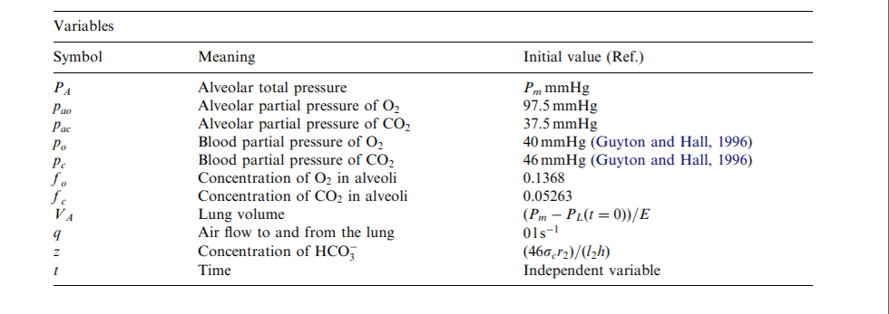
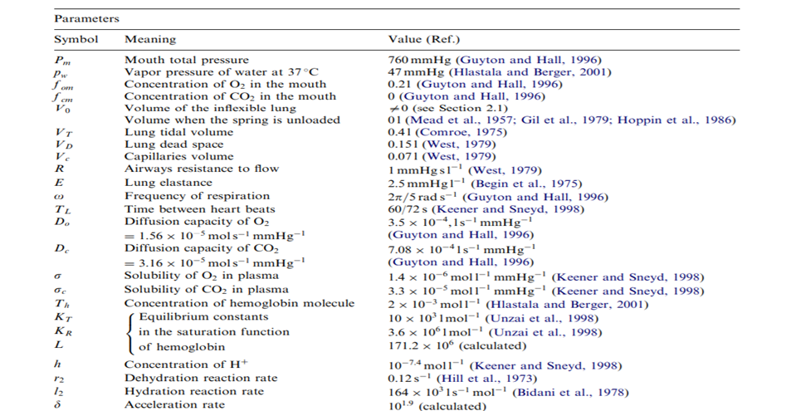
3.Methods
In our method section, we build a model of the gas exchange in human lungs that allows the the interactions via the gas exchange process. First, we chose the system then select the research paper we want to work on and our paper ides. After that, we build a mathematical model using OpenCOR to achieve our results. A hierarchy of very simple models for gas exchange in the human lungs is presented in this study
the materials we used (the model file and the software name)?
This CellML model runs in both PCEnv and COR.

Slide 7
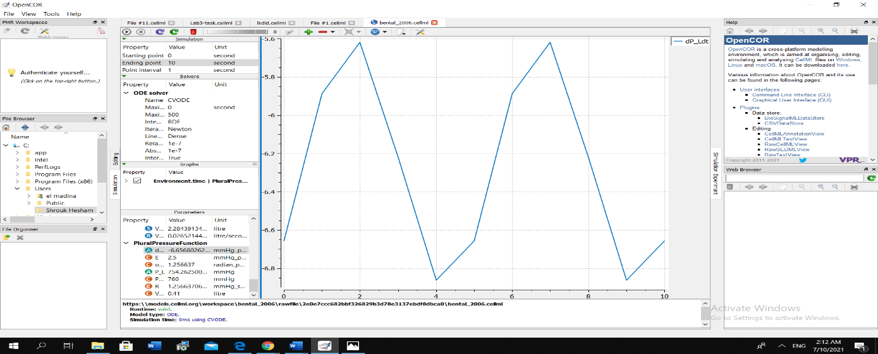
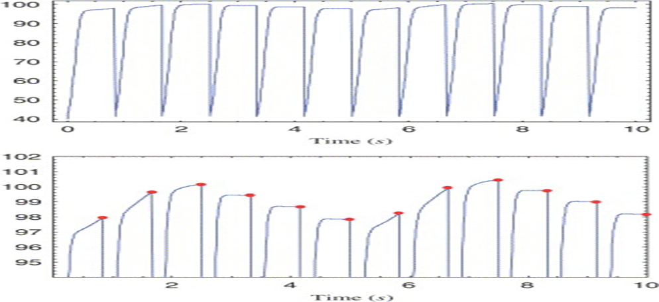
4.Results
In this paper some of the findings are used to validate the models, while others are used to demonstrate the benefits of moving between models, and still others give new information on the physiological system.
Figure (4): Shows that every heartbeat, the blood partial pressure readings are changed.
Figure (5): Shows a "moving" conveyor. (a) Every heartbeat, the blood partial pressure readings are re-initialized. (b) To determine the solutions at the end of the pulmonary capillaries, a sample of the solution is taken at the conclusion of each inter-beat interval.

Slide 8
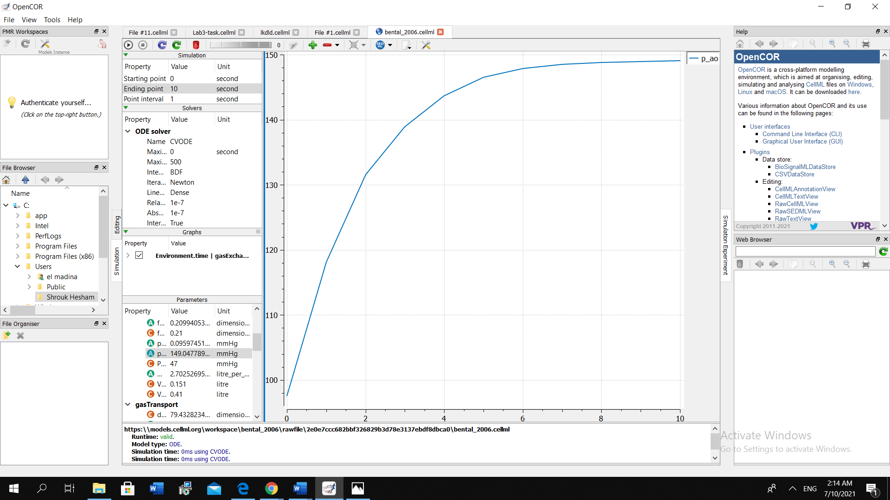
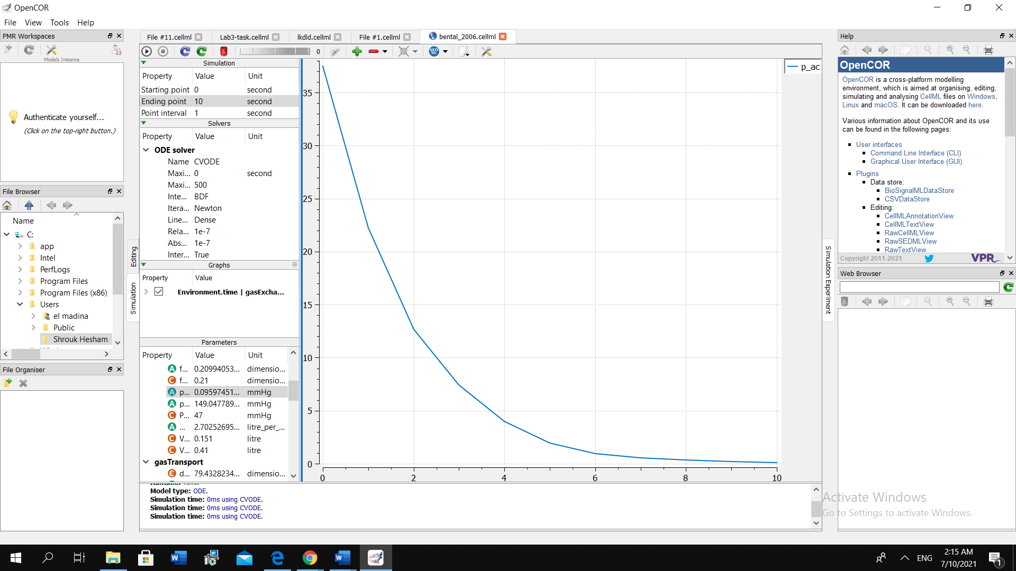
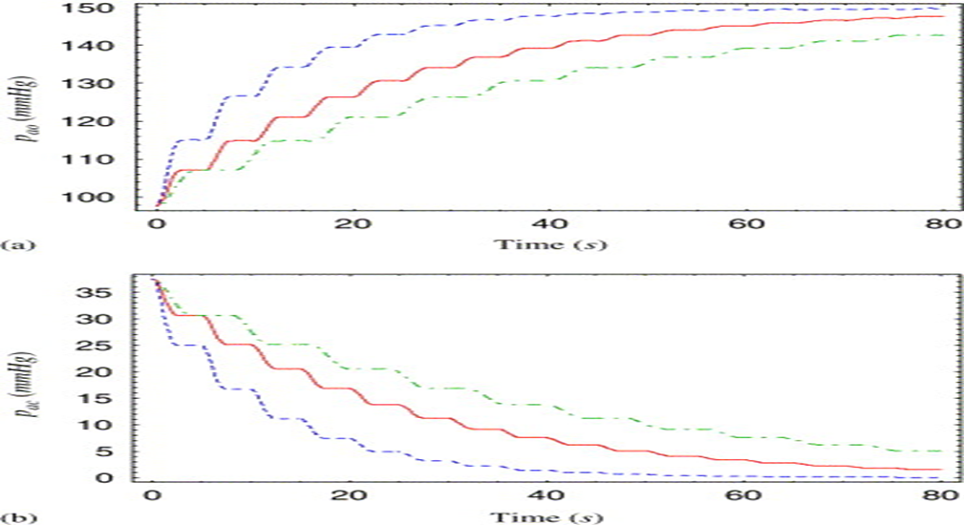
4.Results
Figure (6): Shows oxygen partial pressure in the alveoli.
Figure (7): Shows carbon dioxide partial pressure in the lobes
Figure (8): Shows that We use the flexible lung model with gas exchange when, (a) Oxygen partial pressure in the alveoli. (b) Carbon dioxide partial pressure in the lobes. the convergence time towards steady-state solutions is longer but the results do not change qualitatively).

Slide 9
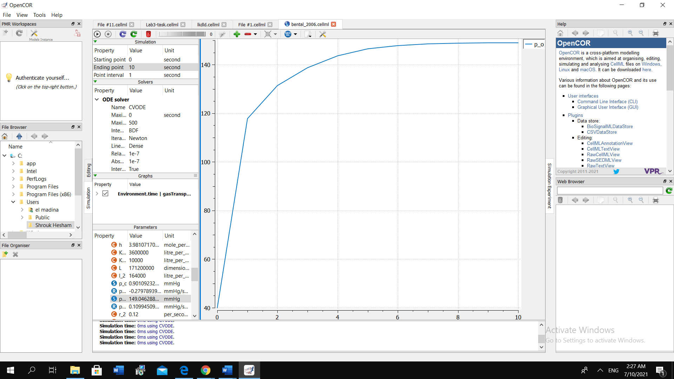
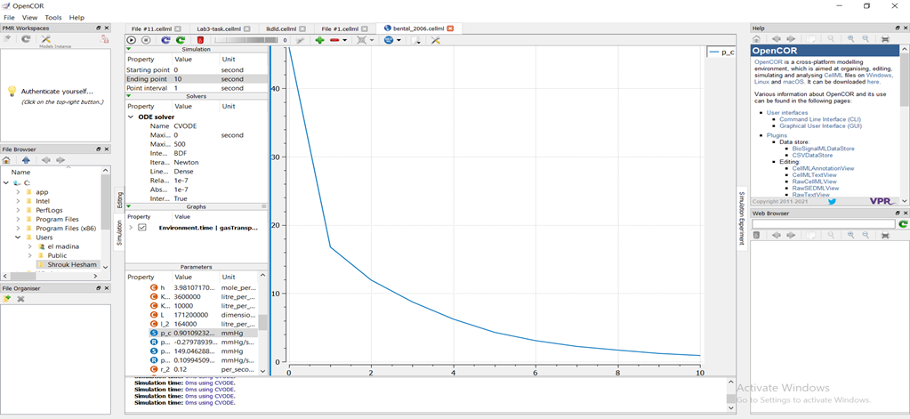
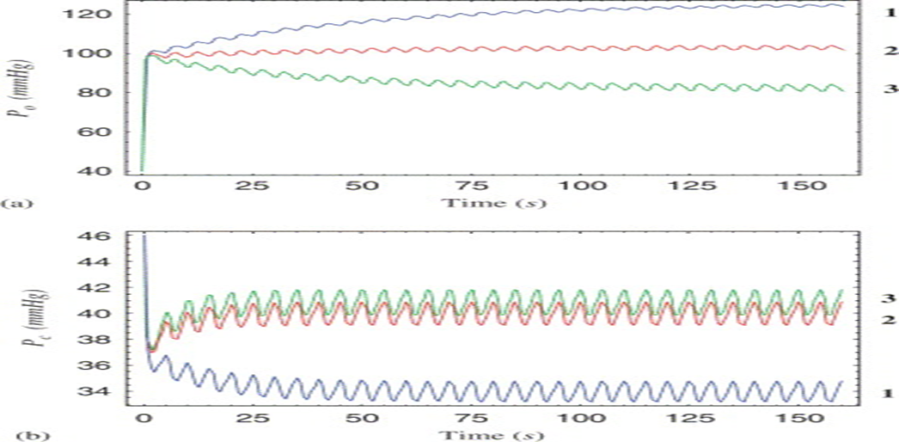
4.Results
Figure (9): Shows the effect of blood flow on oxygen partial pressure in the blood.
Figure (10): Shows the effect of blood flow on carbon dioxide partial pressure in the blood.
Figure (11): Simulations of the flexible lung model with gas exchange and gas transport. (a) Effect of blood flow on blood partial pressure of oxygen. (b) Effect of blood flow on blood partial pressure of carbon dioxide.

Slide 10
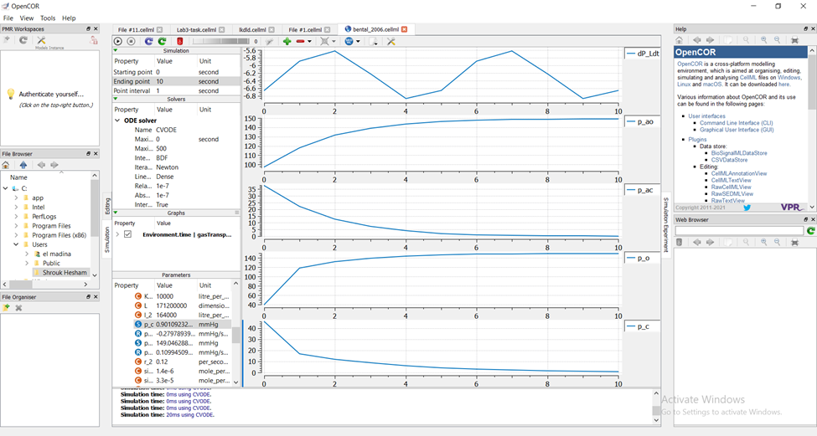
4.Results
Figure (12): Shows our final result using OpenCOR tool for all of our graphs.

Slide 11
5.Discussion
In this section, we provided a brief discussion for our results. Showing that as our heart beats faster, healthy blood vessels will expand in size to allow increased blood flow, which helps our blood pressure remain relatively stable. The oscillations are caused by the combined effects of heart rate and breathing frequency. This result serves to validate the numerical simulations of the flexible lung model with gas exchange, as shown in figs (6,7).
Then our results have shown that, alveolar partial pressure of oxygen (PAO2) Once air is warmed and humidified in the nose and upper respiratory tract, the pressure of oxygen decreases while concentration of H2O increases, thus altering effective PO2 in this gas mixture. PaCO2 is the carbon dioxide partial pressure in alveoli, in which impacts the available partial pressure of oxygen throughout the body. We use the flexible lung model with gas exchange when, (a) Oxygen partial pressure in the alveoli. (b) Carbon dioxide partial pressure in the lobes. the convergence time towards steady-state solutions is longer but the results do not change qualitatively). It can be observed that the partial pressures in the lung eventually equilibrate with the partial pressures of the blood, as shown in figs (8,9,10).
After that our results have shown that, gas exchange and gas transport simulations using the flexible lung model. (a) The effect of blood flow on oxygen partial pressure in the blood. (b) The effect of blood flow on carbon dioxide partial pressure in the blood.it can be seen that an increase in cardiac output (a higher heart rate or a larger stroke volume) will reduce the alveolar partial pressure of oxygen (or increase the partial pressure of carbon dioxide) because more oxygen is taken up by hemoglobin (and more carbon dioxide is released), as shown in figs (11, 12, 13).

Slide 12

6.Conclusion
In these section after some of the results are used to validate the models, some are used to illustrate the advantage of moving between models and some provide new insights to the physiological system. the averaged models provided a qualitative explanation of the numerical results that were obtained by the more complex models. A hierarchy of very simple models for gas exchange in the human lungs is presented in this study. In this work, mathematical modelling is regarded as a dynamic process in which basic and detailed models are applied forwards and backwards on a continually. The relationships between the models in this paper have been established. The idea that simplified models are simpler to understand and provide insight to the system. This study makes a number of assumptions, one of which is that the process of oxygen binding to hemoglobin is close to equilibrium. The fact that the models in this paper may be simplified to simpler models and known models was used to both analytically and quantitatively validate the models.

Slide 13
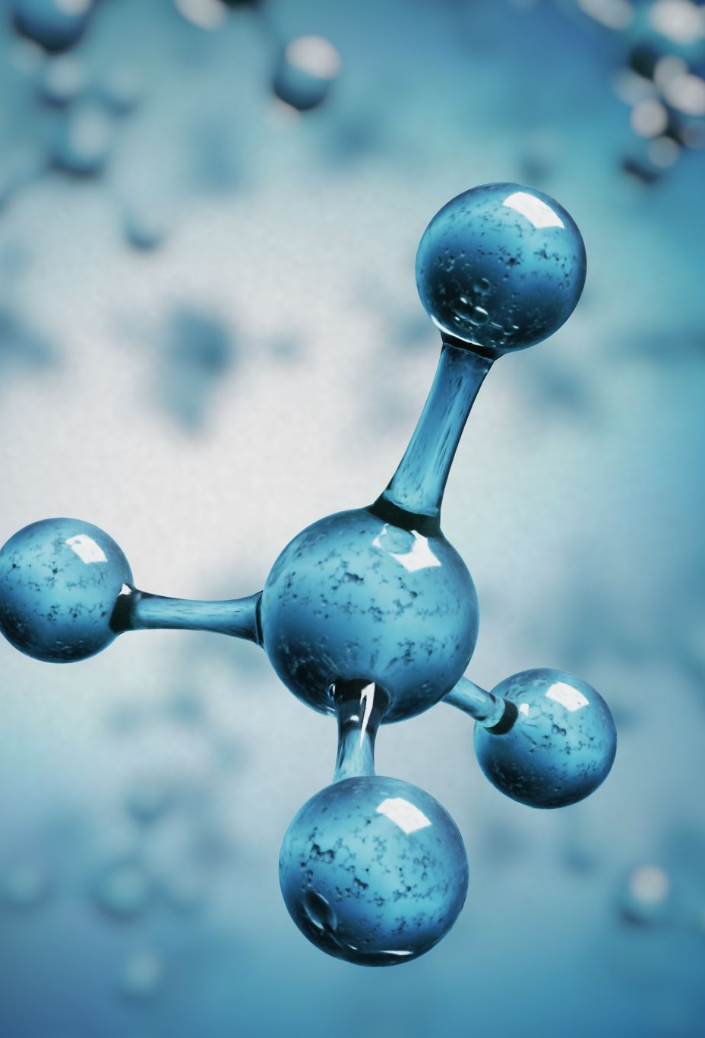
7.Future work
In Future work, the models in this paper can be connected to more complicated lung models. For example, a three-dimensional model of the conducting airways might be linked to the models in this research. Gas exchange is regarded in this paper as the controlled system. While studying the controlled system can provide some insight into the cardio-respiratory system, the control and feedback mechanisms are important for understanding synchronization and Cheyne–Stokes’s respiration and will be covered in the future.

Slide 14
8.References
Sources:
Kalamangalam, G.P., 1995. Nonlinear oscillations and chaos in chemical cardiorespiratory control. Ph.D. Thesis, University of Oxford, UK, http://www.maths.ox.ac.uk/research/theses/
Lu, K., Clark Jr., J.W., Ghorbel, F.H., Ware, D.L., Bidani, A., 2001. A human cardiopulmonary system model applied to the analysis of the Valsalva maneuver. Am. J. Physiol. Heart Circ. Physiol. 281, H2661–H2679
Video’s:
https://www.youtube.com/watch?v=xMRhwmJ6p6Q
https://www.youtube.com/watch?v=28CYhgjrBLA
https://www.youtube.com/watch?v=JDWeq0xg9nA

Slide 15
